Slide 1
Adventure Works
Power BI, SQL Database, and Python Integration
Presented By:-
Manas Jadhav
Manobrath Dutta
Sandeep Tudu
Iruvuri Bhargav Ram

Slide 2
OBJECTIVE
Create a real-time Power BI dashboard connected to an SQL database
This project aims to create a dynamic, real-time dashboard in Power BI using the Adventure Works dataset.
The dashboard provides valuable insights, including sales performance, regional analysis, and target achievements.
Tools Used :
Power BI
SQL
Python
Google API

Slide 3
PROJECT OVERVIEW
Data cleaning and processing
SQL Database Integration
Power BI Dashboard
Real-Time Updates
GitHub Documentation

Slide 4
DATASET PROCESSING
Download the dataset, upload it to Google Drive, clean it with Python, and prepare for SQL loading.
Data Processing:- Utilize Python and pandas to load and clean the Adventure Works dataset.
Perform tasks such as Handling missing values.
Normalizing data formats to ensure consistency across datasets.

Slide 5
SQL DATABASE INTEGRATION
Create SQL database, structure tables, and import cleaned data to support insights.
Populate the database with cleaned data for efficient querying and storage.
Create a normalized schema to avoid redundancy and maintain data consistency.

Slide 6
POWER BI DYNAMIC DASHBOARD
Connect Power BI to SQL database, design visualizations for KPIs, and user-friendly interface.
Build an interactive dashboard featuring
- Key sales metrics.
- Regional performance breakdown.
- Target achievement visualizations.
Top performance products:- A bar chart highlighting revenue contributions of top products.

Slide 7
REAL-TIME UPDATES
Set up real-time data refresh in Power BI to reflect changes in the SQL database.
Enable automatic data refresh in Power BI to reflect real-time changes from the MySQL database.
Configure updates either at regular intervals or based on SQL triggers.

Slide 8
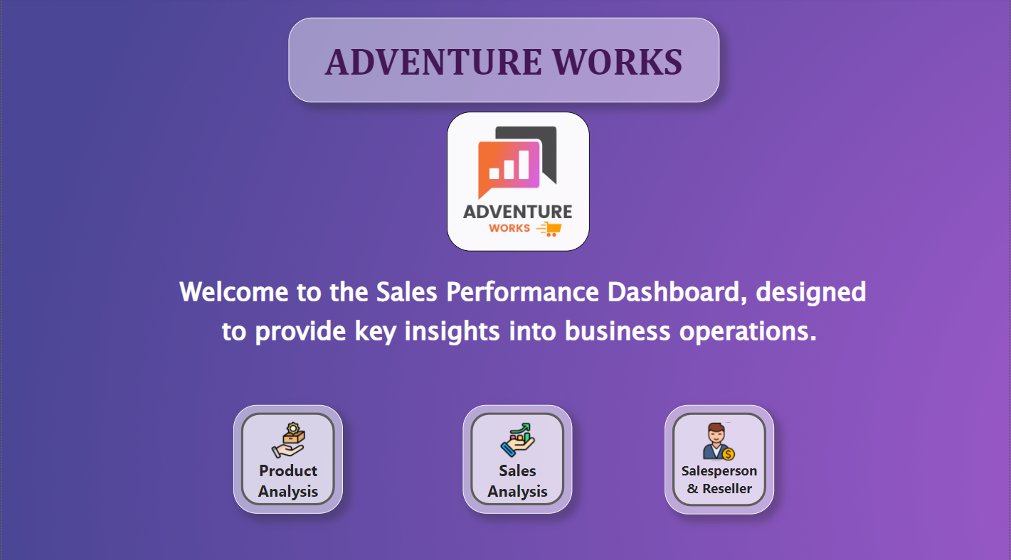
DASHBOARD

Slide 9
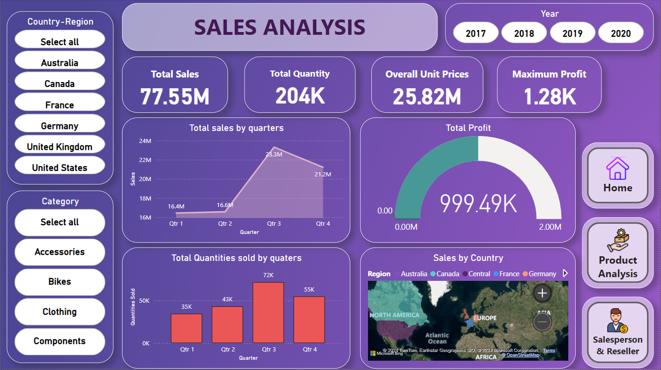
SALES PERFORMANCE OVERVIEW
Overall Sales
Quantity Sold
Average Unit Price
$ 77.35
204K
$ 25.82

Slide 10
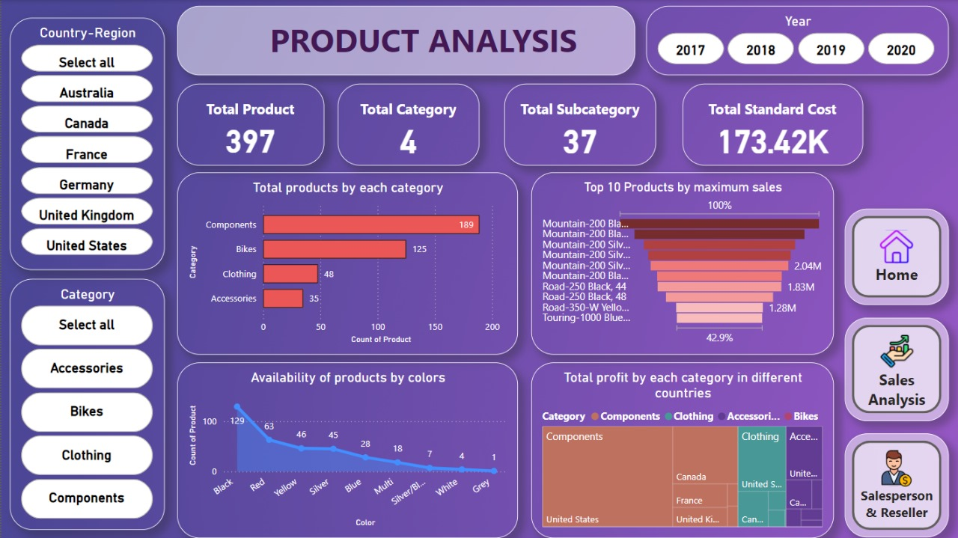
PRODUCT ANALYSIS
The above graph shows the analysis of the products.
Graph shows the total sales of products across different countries.

Slide 11
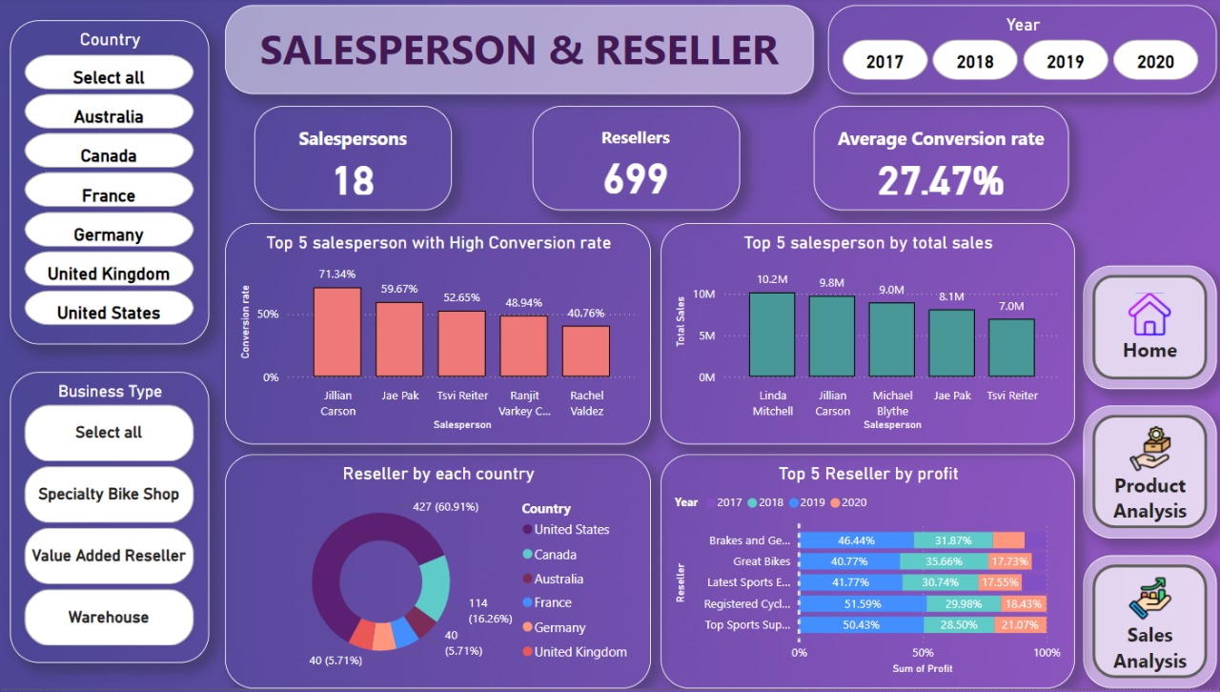
SALESPERSON & RESELLER
Graph showcasing the different resellers and salespersons
Graph shows the different sales person across different countries

Slide 12
CONCLUSION
This project successfully combines Python, MySQL, and Power BI to deliver a powerful, scalable dashboard solution. It enables real-time, data-driven insights for stakeholders, enhancing decision-making capabilities and laying a foundation for future advancements like AI-powered analytics and expanded datasets.

Slide 13
THANK YOU!

